Slide 1
Sports & Religion:
A Comparison

Slide 2
Religion: Basic Elements
religio—respect for something sacred

Slide 3

unified body language
food & alcohol
public displays
fallen heroes
good guys & bad guys
male dominated with females on the sides
good/evil dichotomy

Slide 4
strong beliefs that can evoke violent actions
faith in the unknown
ritualistic practices
symbols & stories
cultural universal
feasts & festivals
intercession with the supernatural
sacrifice & service
meditation & prayer
music, art, chants, & songs
social institution
burial practice

Slide 5
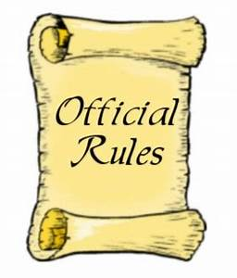
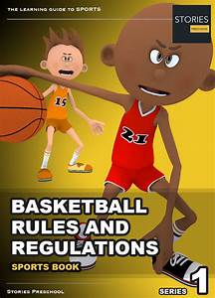
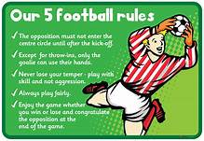
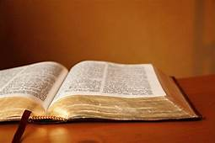
RULES
Sport has a body of formally stated rules based on beliefs, accepted on faith by great masses of people.

Slide 6
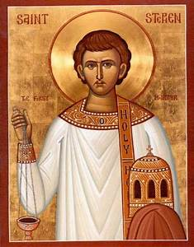
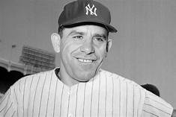
SAINTS
Sport has its "saints" --those departed souls who in their lives exemplified and made manifest the prescription of the dogma of the sport.

Slide 7
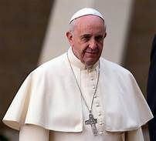
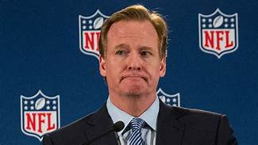
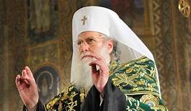
PATRIARCHS
Sport also has its ruling patriarchs, a prestigious group of coaches, managers, and sportsmen who exercise controlling influence over national sport organizations.

Slide 8
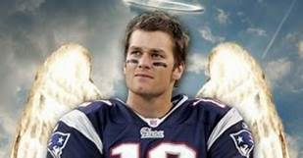
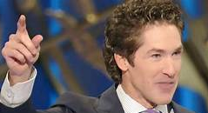
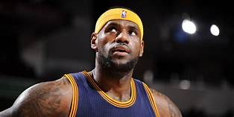
Sport has its "gods" --star and superstar athletes who, though powerless to alter their own situations, wield great influence and charisma over the masses of fans.
SPORT GODS

Slide 9
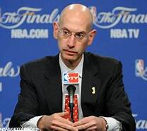
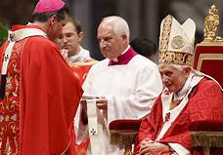
Sport has it high councils, controlled or greatly influenced by patriarchs who make and interpret the rules of sport involvement.
HIGH COUNCILS

Slide 10
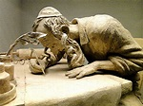
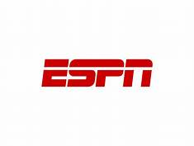
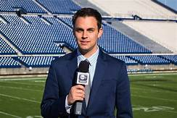
Sport has its scribes--the hundreds of sport reporters, sport telecasters, and sport broadcasters whose primary duties are to record the ongoing history of sport and to disseminate its dogma.
SCRIBES

Slide 11
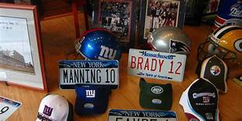
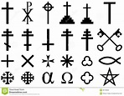
SYMBOLS OF FAITH
Sport has its "symbols of faith"--trophies; game balls, the bats, gloves, baseballs, and so forth that 'won' this or that game; the clothing, shoes, headgear or socks of immortal personages of sports.

Slide 12
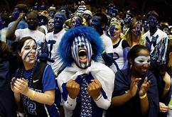
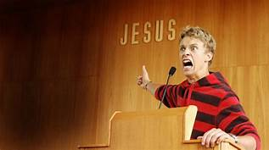
Sport has its "seekers of the kingdom" its true believers, devotees, and converts.
PASSIONATE BELIEVERS

Slide 13
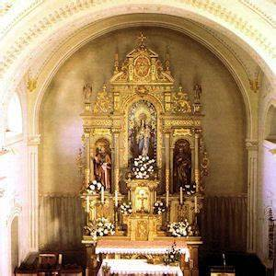
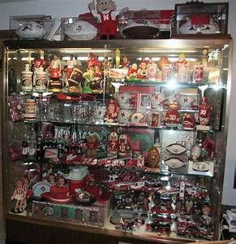
Sport has its shrines—the national halls of fame and thousands of trophy rooms and cases.
SHRINES

Slide 14
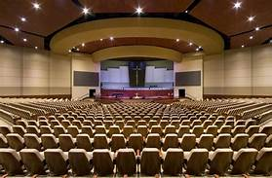
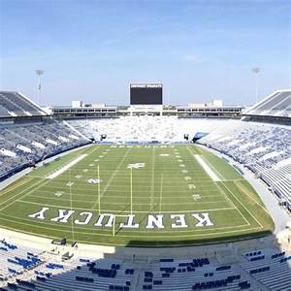
Sport has its places of worship spread across the land where millions congregate to bear witness to the manifestations of their faith.
PLACES OF WORSHIP

Slide 15
Source:
Harry Edwards, a former Sociology professor at the University of California, once
identified 13 areas where sport and religion connect in Sociology of Sport (1973):

Slide 16
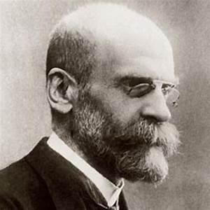
emile Durkheim
sacred objects
binds people together
form of social control
offers strength to life’s transition
in/out group dynamic
anti-semitism
Salem witch trials
Islamophobia

Slide 17
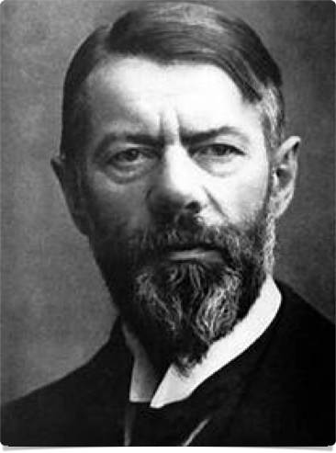
Max Weber
precipitator of social change
Protestant Work Ethic and the Spirit of Capitalism
observed Protestants more likely than Catholics to value capitalist ideology

Slide 18
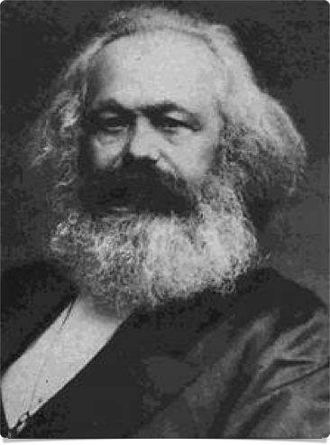
Karl Marx
reflects social stratification
Vatican
divine right of oppressive monarchs
Indian caste system
keeps masses subservient (opium of the masses)

Slide 19
Feminist Perspective
have little power within religion
male-dominated
sets up unequal roles in marriage

Slide 20
Discussion Questions

Slide 21
Why do sociologists study religion?

Slide 22
to understand culture
politics
laws (what is forbidden)
gender roles

Slide 23
How do our religious perspectives affect our
behavior? Does it bring fear, wonder, relief?

Slide 24
Other than your own religion,
which religion do you find
most interesting and why?

Slide 25
List some ways you see religion having
social control in the everyday world.

Slide 26
Do you see a relationship between
religion and social stratification?

Slide 27
Recent Study: Holman found that although religion has many
benefits, it can also cause harm. How can religion
cause harm?

Slide 28
When Religion Hurts: Structural Sexism and Health in Religious Congregations,
Homan & Burdette, 2021
Although religious participation is generally associated with positive health outcomes,
many religious institutions create and reinforce a high degree of structural sexism,
which is harmful for health.
https://journals.sagepub.com/doi/full/10.1177/0003122421996686

